Slide 1
OUR SCHOOL
I.I.S.S. “FRANCESCO D’AGUIRRE-DANTE ALIGHIERI”
SALEMI-PARTANNA-SANTA NINFA

Slide 2
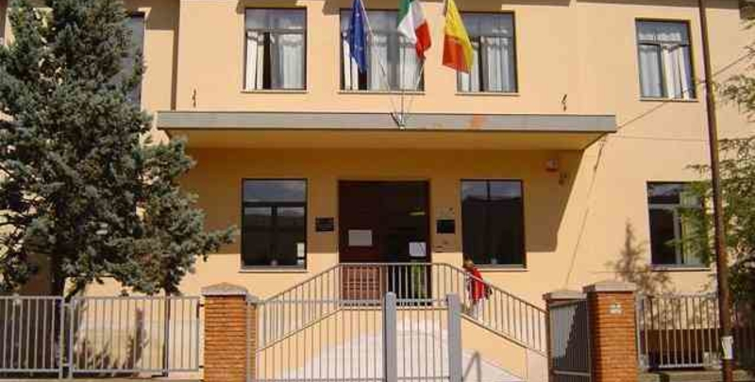
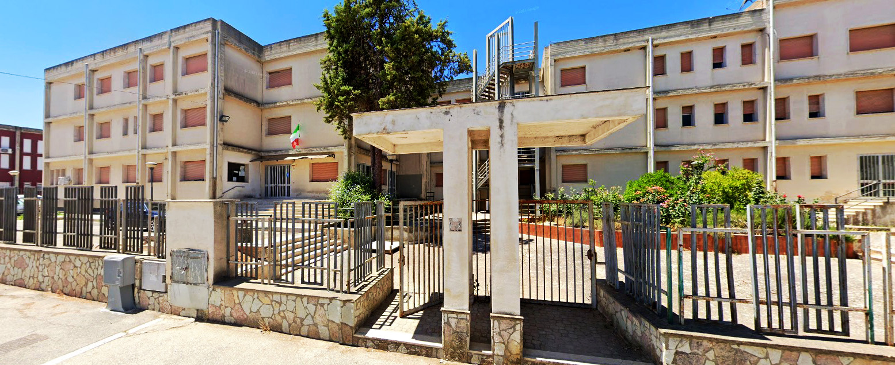
A School for our FUTURE
Our School is located in Salemi in Trapani Land in n Sicily island- In Salemi there is the headquarters of our school. We have also other two locations, one is in Partanna town and another in Santa Ninfa town

Slide 3
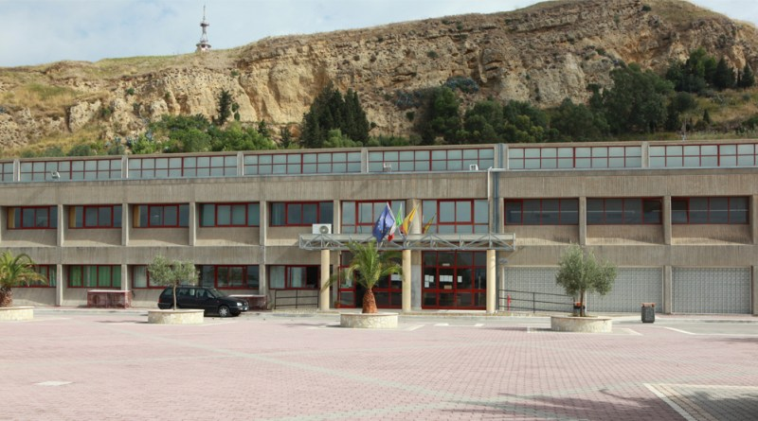
Liceo Classico
The LICEO CLASSICO is a secondary school provided by the Italian education system. Provides non-vocational education aimed at subsequent access to university and any faculty that the latter can offe

Slide 4
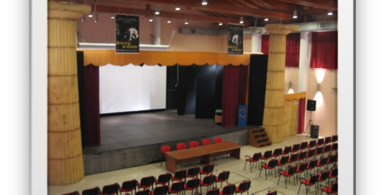
Liceo delle scienze umane
It arises from the evolution of pedagogical and/or social experiments, introduced after the abolition of teacher training institutes.
The "Magistrale" Institute of "Partanna" established in 1936 has a long experience in preparing professionals working in the world of school.
In addition to the solid philosophical, pedagogical and social foundations, it allows you to acquire a good preparation for access to any university faculty.

Slide 5
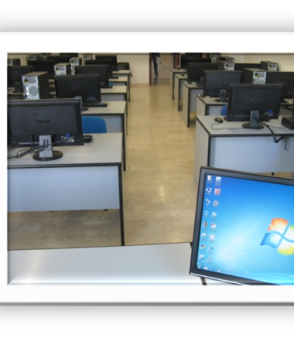
Scientific High School
The course of the scientific high school deepens the link between science and humanistic tradition, provides the languages, knowledge and skills necessary to follow and understand the development of scientific and technological research and to identify the interactions between different forms of knowledge. It allows access to any university faculty.

Slide 6
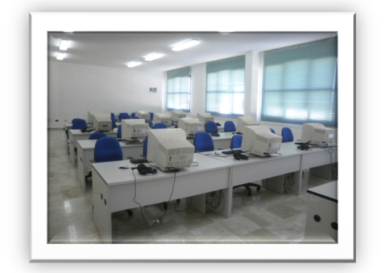
Liceo linguistico
The path of the linguistic high school allows you to acquire the knowledge, skills and competences necessary to mature the communicative mastery of different languages, in addition to Italian. It offers employment prospects in a world without cultural barriers. It allows access to any university faculty.

Slide 7
Istituto tecnico settore economico
Amministrazione Finanza e Marketing Articolazione Sistemi Informativi Aziendali
The course is characterized by specific technical-economic training related to the areas of economics, business administration, marketing and civil and tax regulations. It provides a solid foundation for dealing with the world of work. It allows access to any university faculty.

Slide 8
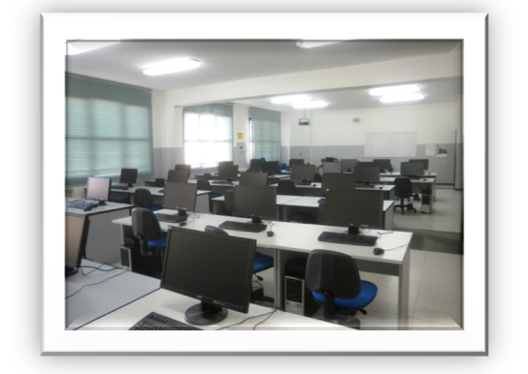
Istituto tecnico settore economia finanza e marketing
He course, through a decisive computer cut on a technical-scientific basis, provides students with the skills and knowledge necessary to design and organize products and services in the economic sector, with the help of computer applications. The choice of this address offers more employment opportunities and allows access to any university faculty.

Slide 9
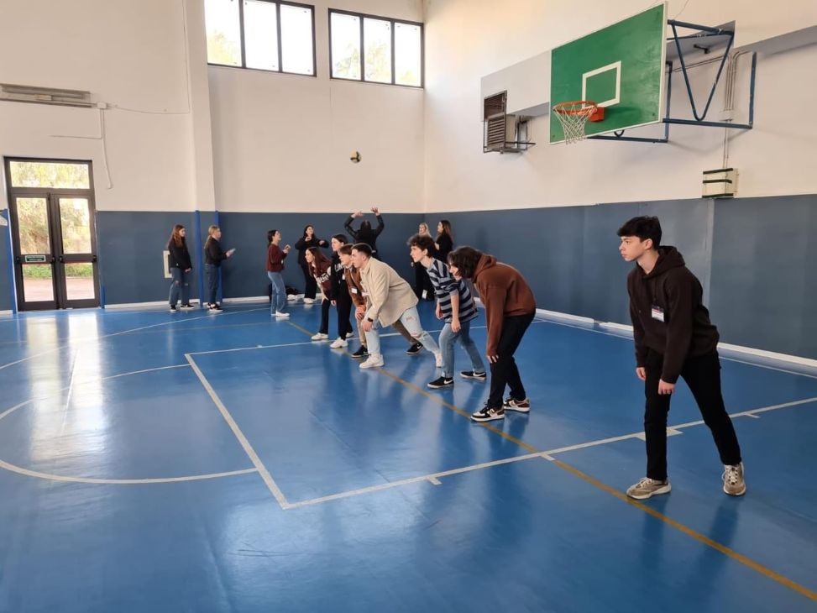
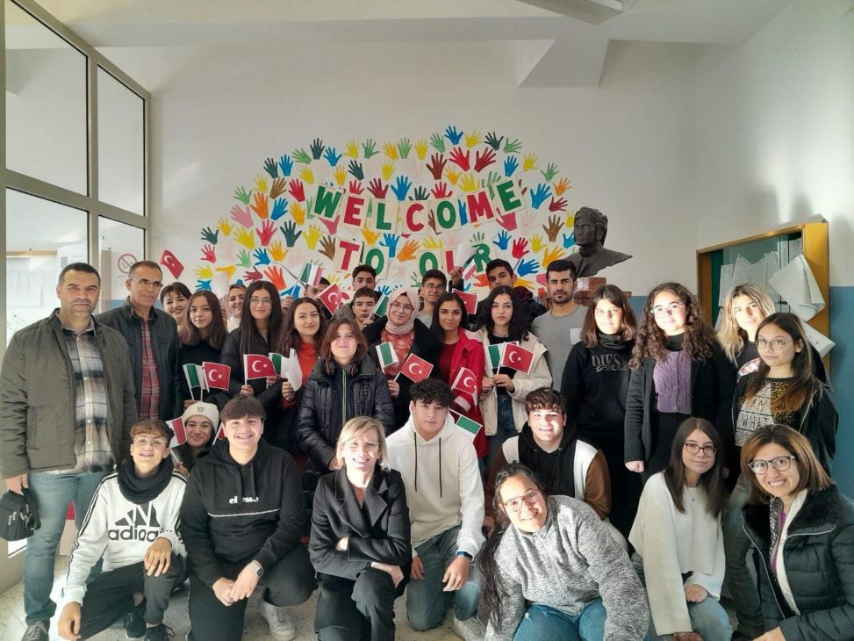
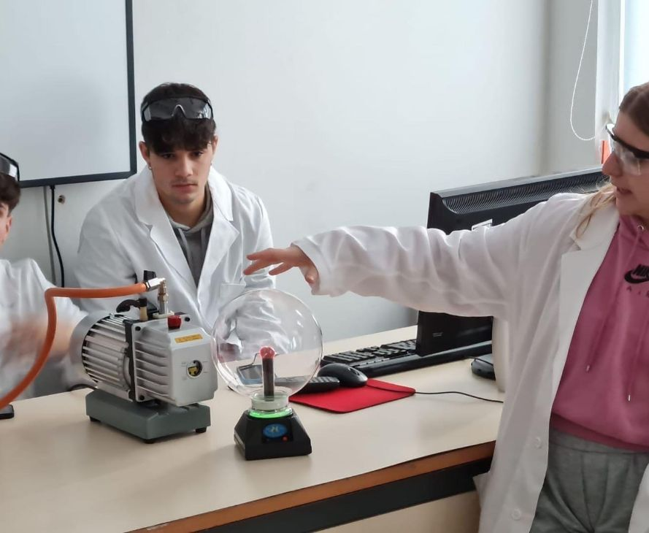
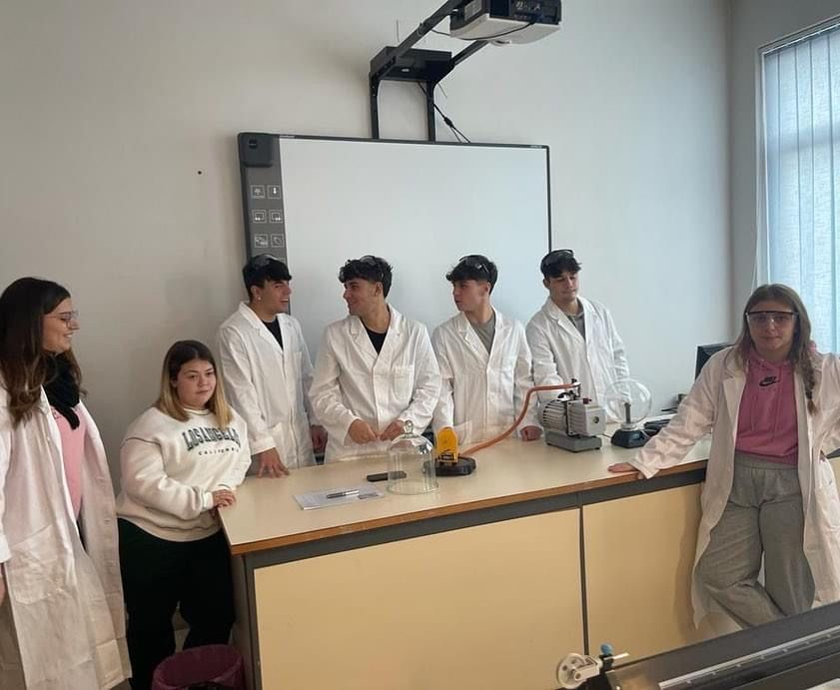
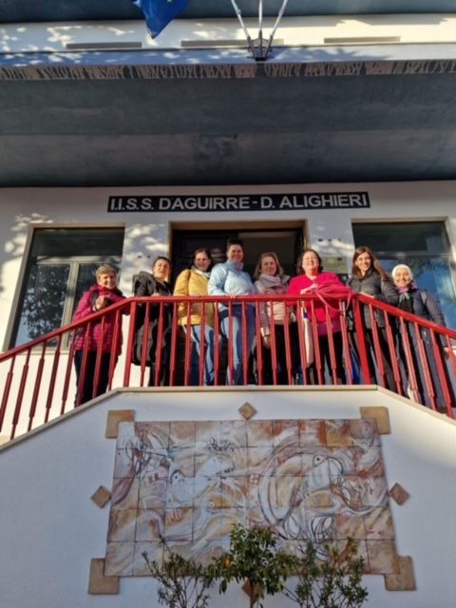

Slide 10
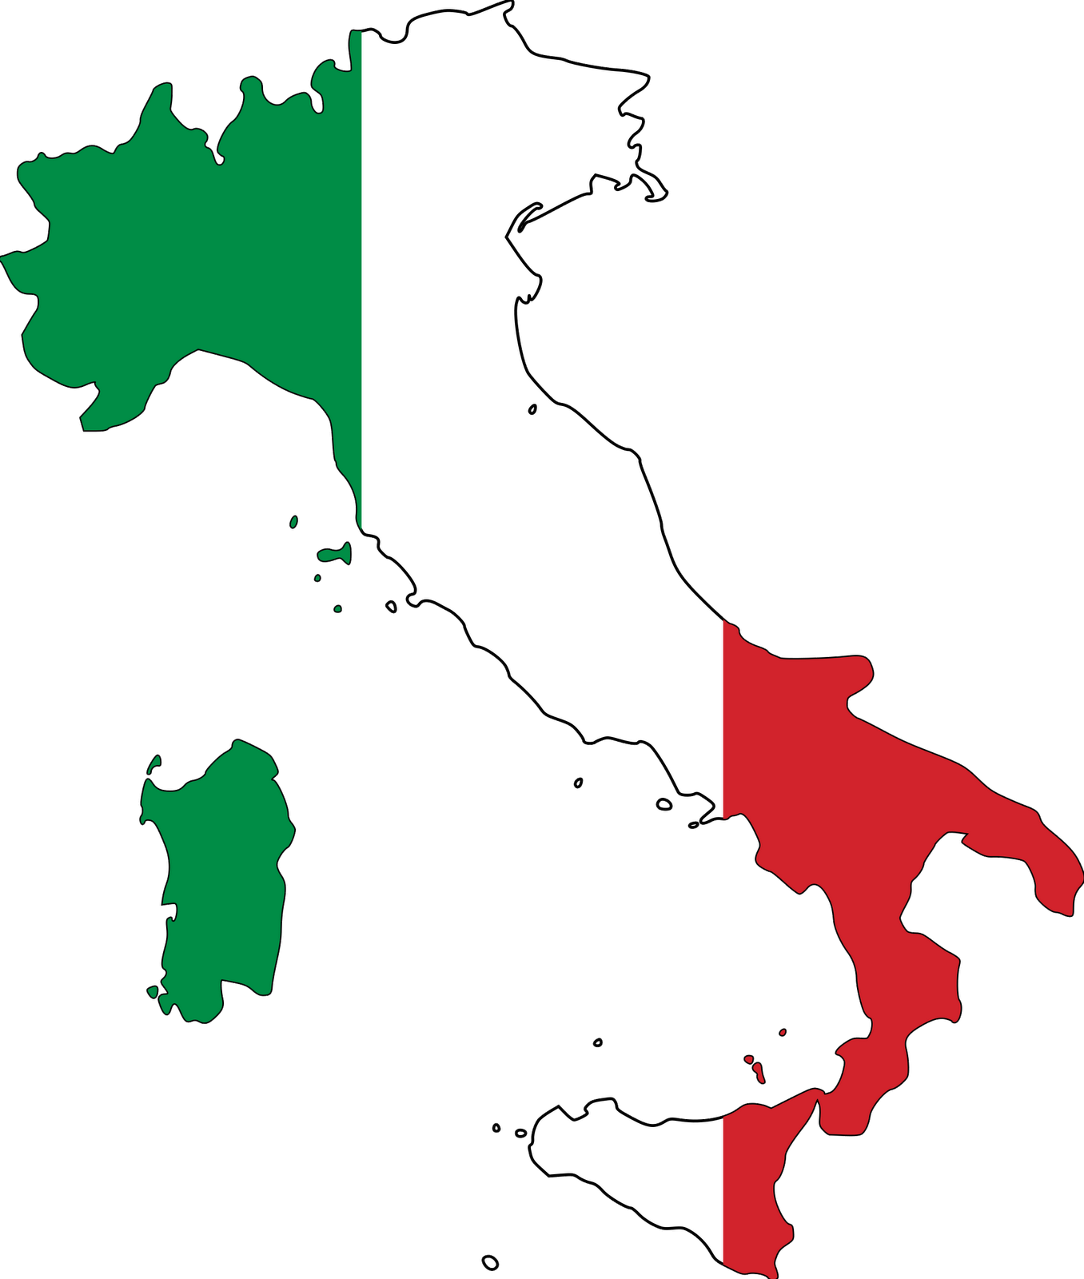
THANK YOU
For your attention!
ENJOY OUR ERASMUS

