Slide 1
TURKIYE

Slide 3
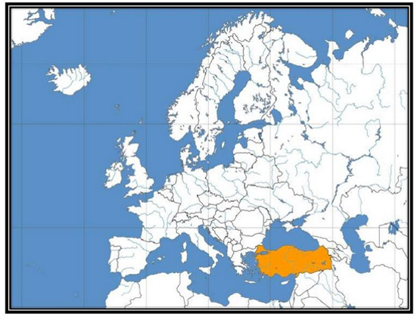
Turkey is on the north hemisphere between
Europe and Asia Continents

Slide 4
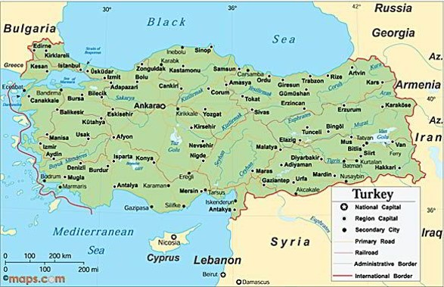
It’s like a bridge between Asia and Europe. Mediterranen Sea,Aegean Sea and Black Sea surround our country

Slide 5
Our neighbours are Greece,Bulgaria,Iraq,Syria,Iran and Georgia.

Slide 6
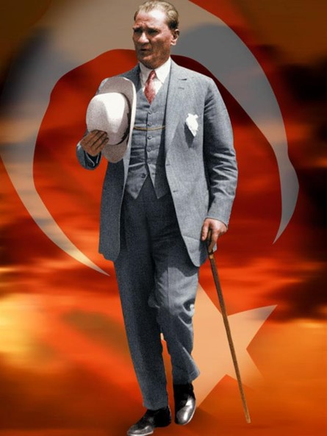
Turkey was founded by Ataturk in 1923
Turkey is a republic
Our official language is Turkish
Ankara is the capital city of Turkey
Currency of Turkey is Turkish Lira

Slide 7
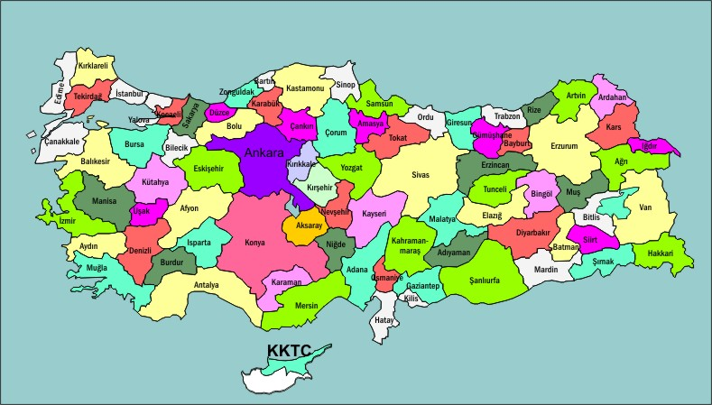
There are 81 cities in Turkey.Our school is in Istanbul

Slide 8
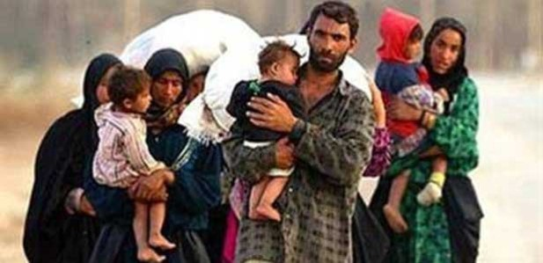
Population
Our population is over 80 million
In addition, 2 million Syrians emigrated to Turkey

Slide 9
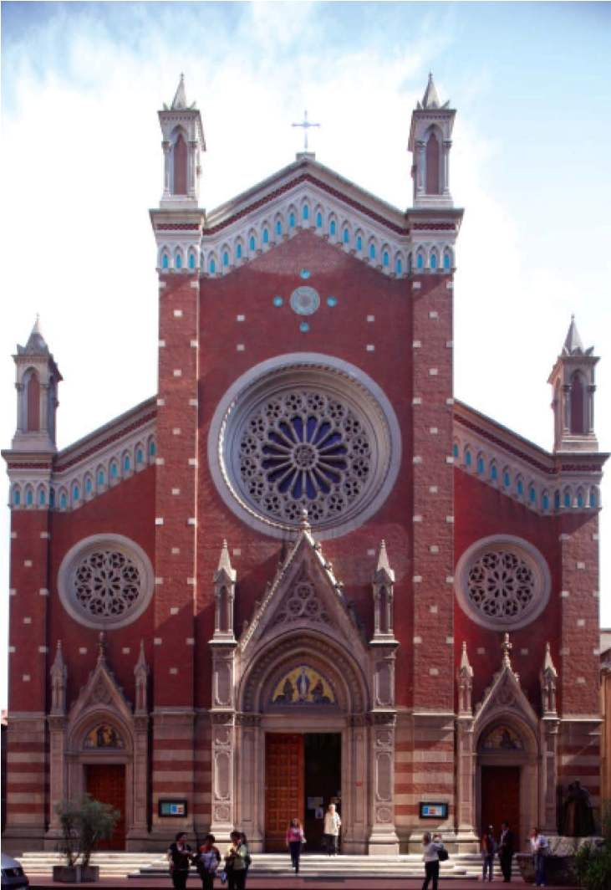
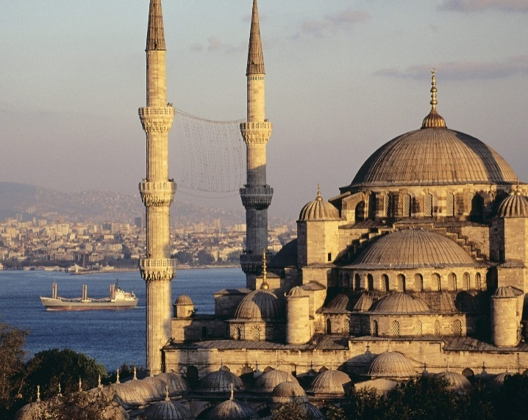
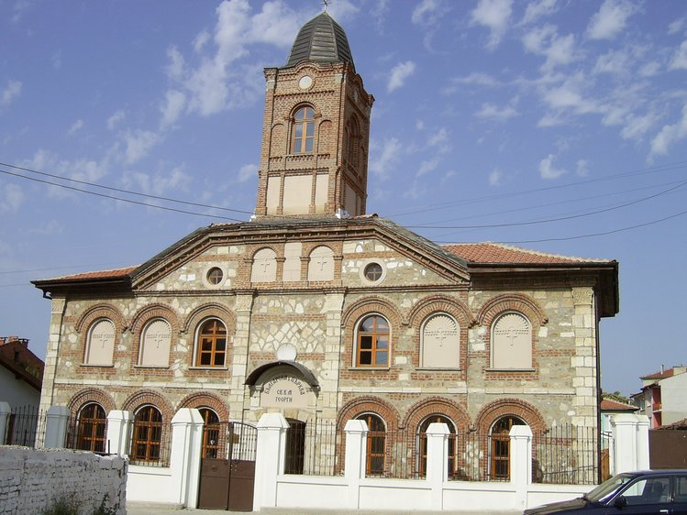

Slide 10
Turkey is a secular country. Goverment and religious issues are seperated from each other
Everybody is free to choose his/her own religion in our country.
Most of people are Muslim.On the other hand ,Christian and Jewish people live in our country.
There are many mosques,churches and synagogues in many cities

Slide 12
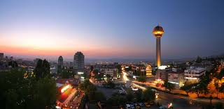
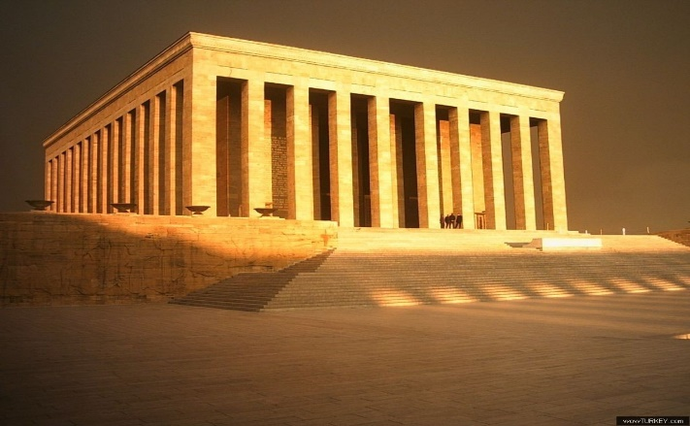

Slide 13
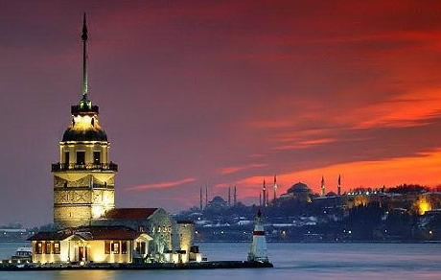
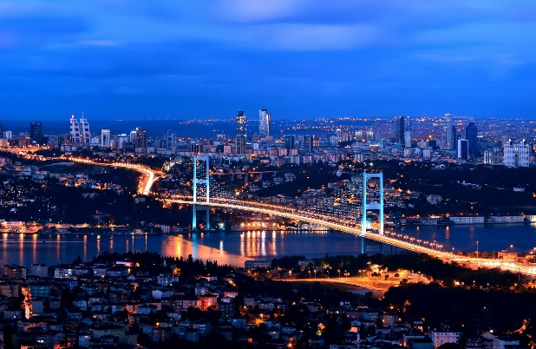

Slide 14
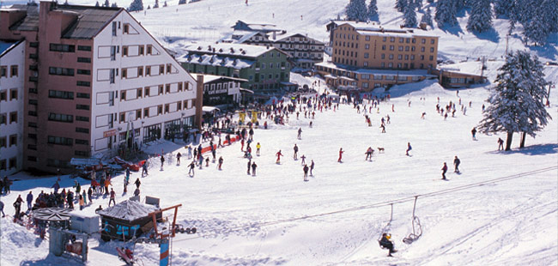
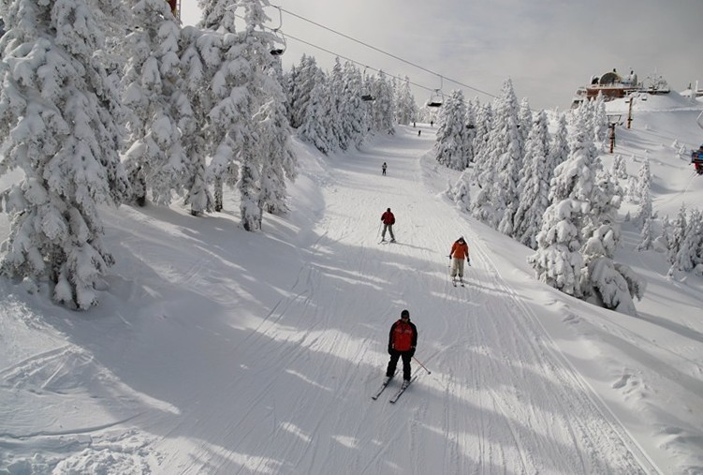
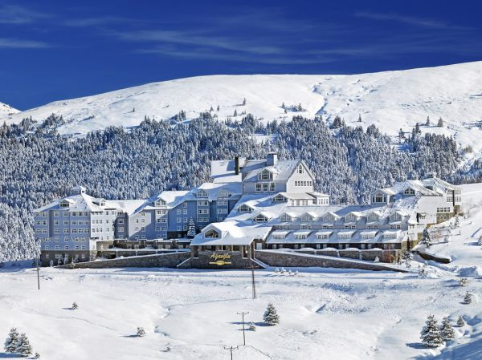
Bursa is ski center in Turkey.

Slide 15
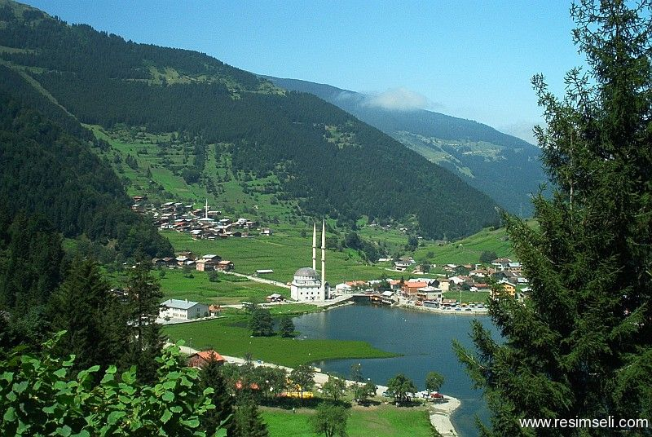
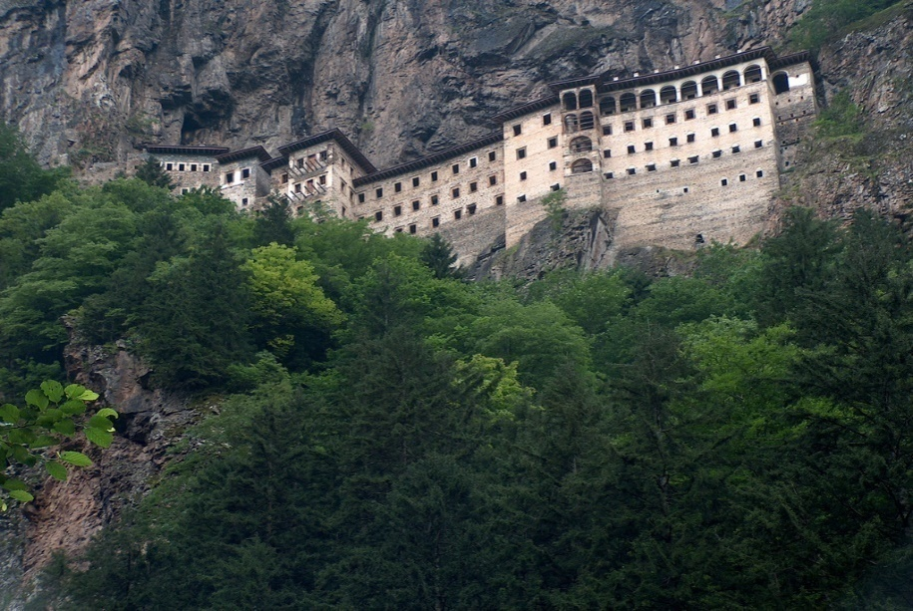

Slide 16
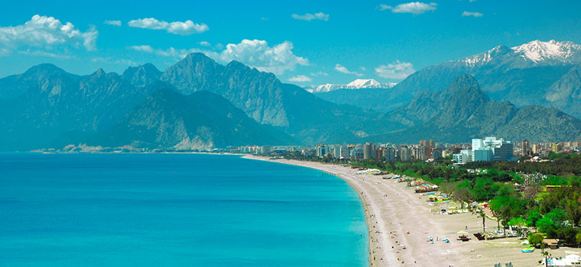
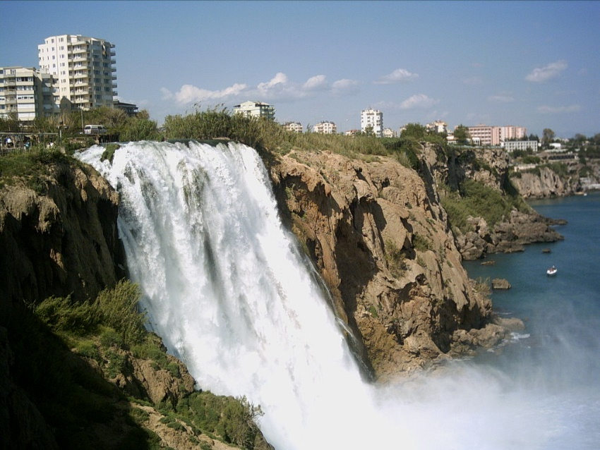
ANTALYA
Antalya is a huge tourist destination.Every year many tourists visit Antalya. It is a city of sea,sand and sun.

Slide 17
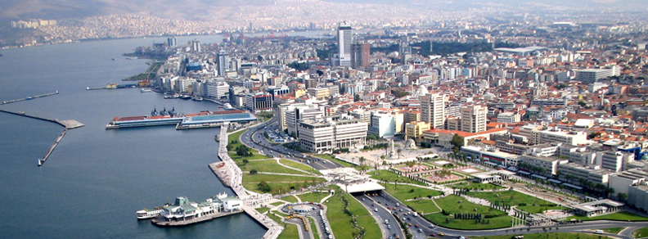
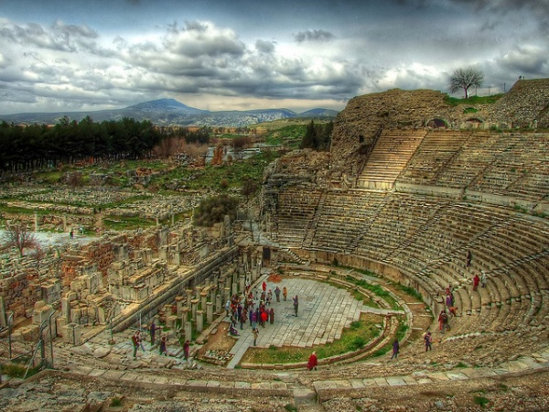
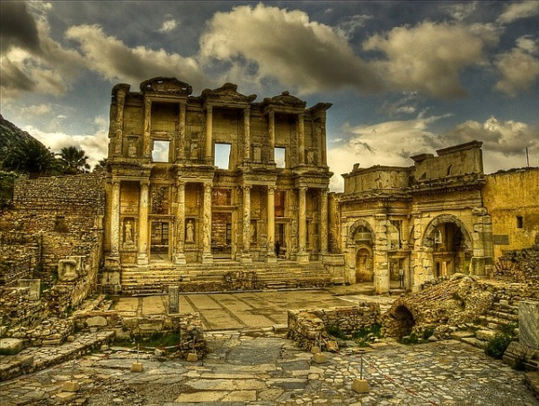
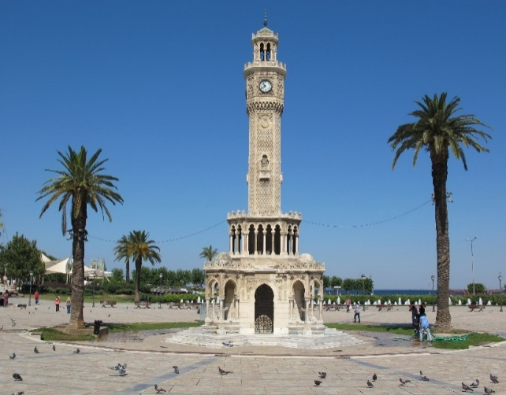
İZMİR
İzmir is a beautiful port city of in Turkey. The ancient city of Ephesus is located here.

Slide 18
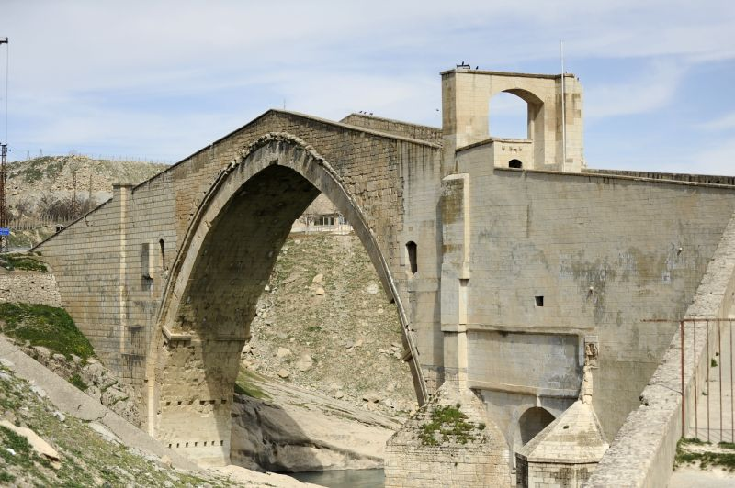
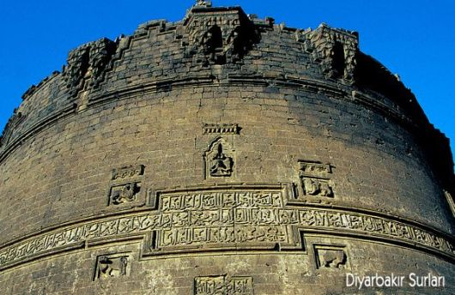

Slide 19
TOURISTIC and HISTORICAL DESTINATIONS

Slide 20
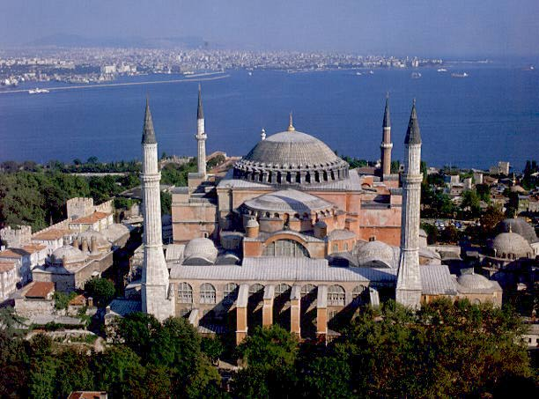
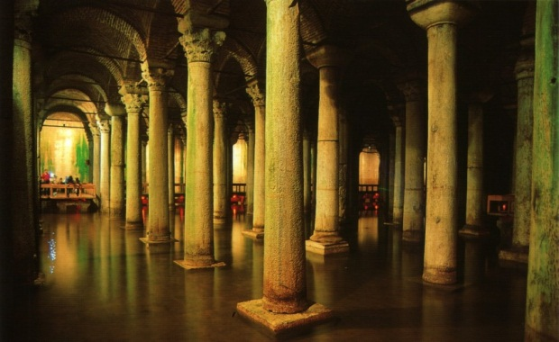
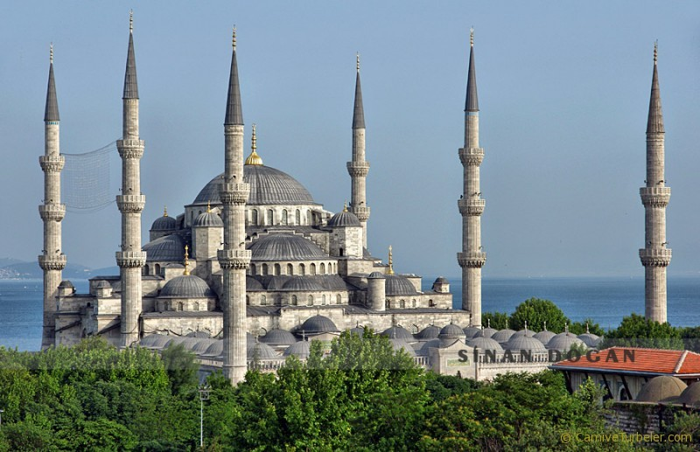
Istanbul has a lot of Ottoman and Byzantine Empires monuments
Hagia Sophia
Maiden's Tower
Basilica Cistern
Blue Mosque

Slide 21
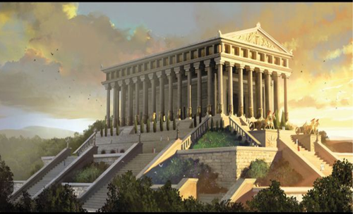
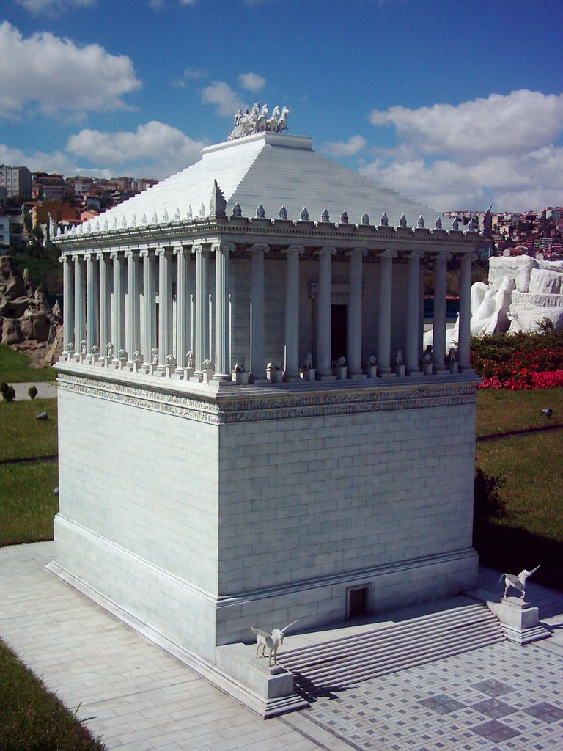
Two of the seven marvels of ancient world are in Anatolia.
The mausoleum
at Halikarnassos
The temple of Artemis

Slide 22
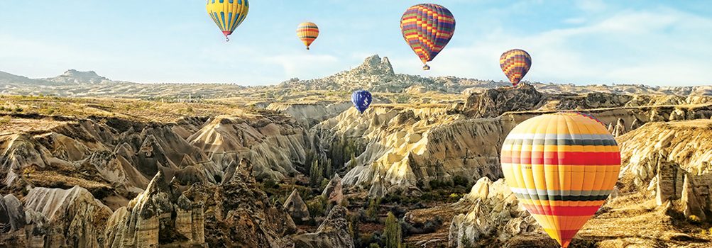
CAPPADOCIA
It is a historic area of Central Anatolia Region.
It has a lunar-like landscape(Fairy chimneys)
The caves and underground cities

Slide 23
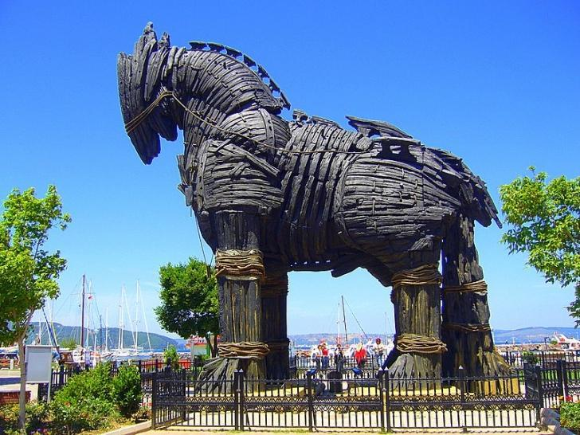
TROY
The city of Troy is located on the western part of Turkey,in Çanakkale

Slide 24
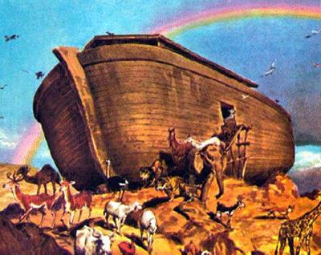
NOAH’S ARK
Some explorers claim that Noah’s Ark landed on Mount Ararat in Turkey
Some Christians believe that the Mount Ararat is the final resting place of Noah’s Ark.

Slide 25
Thank you for listening

