Slide 1
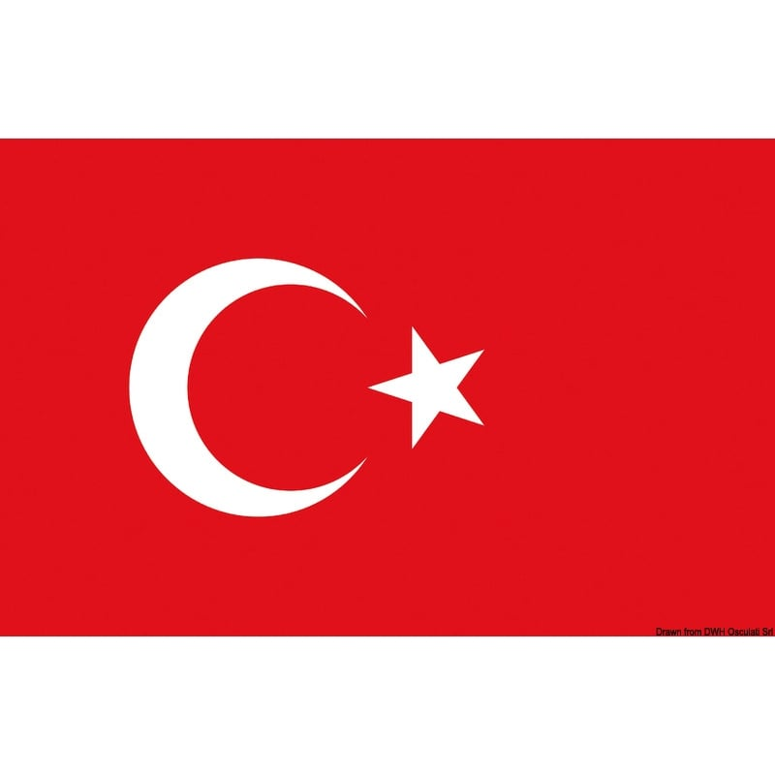
“Developing Flexibility for a Future Labor Market”
Code 2021-1-IT02-KA210-SCH-000027275

Slide 2
The work in Italy
The Constitution states that work "is a right which consists in carrying out, according to one's possibilities and choice, an activity or function which contributes to the material or spiritual progress of society". The first paragraph of art. 1 of the Constitution states: "Italy is a democratic republic founded on work".

Slide 3
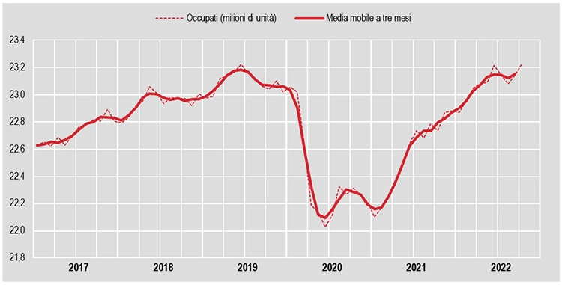
Percentage of work in Italy
Compared to March 2021, the growth in the number of employed persons is equal to 804,000 units and in over half of the cases it concerns temporary employees, whose estimate reaches 3,150,000 (the highest value since 1977). The employment rate stands at 59.9% (record since the beginning of historical series).

Slide 4
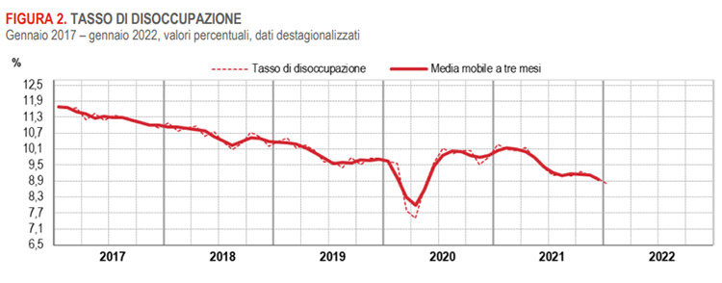
UNEMPLOYMENT IN ITALY, DECEMBER 2022 DATA
The total unemployment rate is stable at 7.8%, the youth rate drops to 23% (-0.6 points). The increase in the number of inactive people between the ages of 15 and 64 (+0.4%, equal to +49,000 units) involves men, women and those aged at least 35. The inactivity rate rises to 34.5% (+0.1 points).

Slide 5
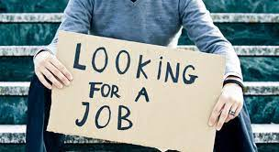
Unemployment Causes
There are many causes of youth unemployment in Italy. Among the main reasons are the country's low economic and financial index, the quality of education, the lack of flexibility and rigid regulation of the labor market and the ineffective policy of overcoming unemployment

Slide 6
Unemployment Fight
Among the EU measures to combat youth unemployment is the Youth Guarantee, a commitment by member states to ensure that all young people under 30 have a supply of quality jobs, continuous training, apprenticeships or internships within four months from the moment they are unemployed or have finished their studies.

Slide 7
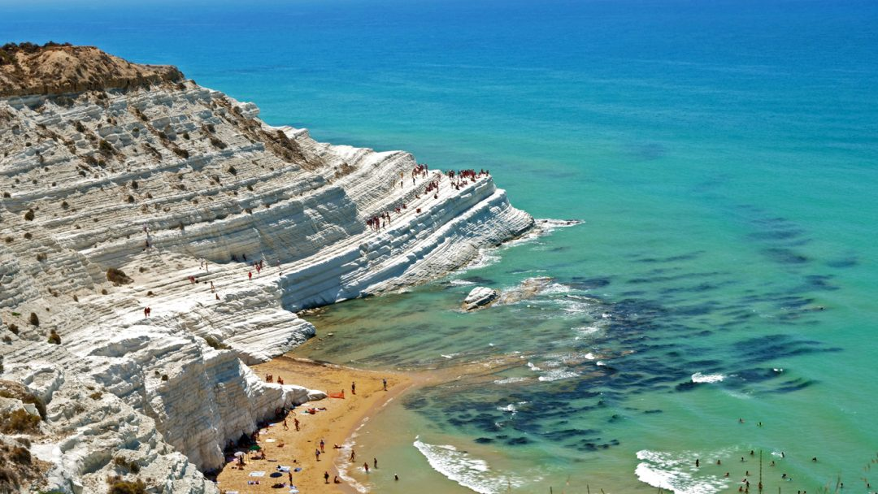
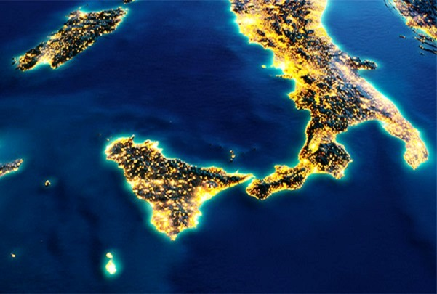
Southern Italy economy
When it comes to the economy of southern Italy, one cannot fail to dwell on the gaps that for many years have separated these regions from the other areas of our country.
For many years, the knots to be solved have always been the same: crime, bureaucracy, infrastructural deficiencies, unemployment, all recurring themes that have worsened in the last 25 years.
Among the state investments to help businesses in the South, we find "Resto al Sud" the tax break that encourages the development of new businesses and supports existing ones based in the South, especially those of the younger ones. The funds are managed by Invitalia and are aimed at entrepreneurs between the ages of 18 and 55.

Slide 8
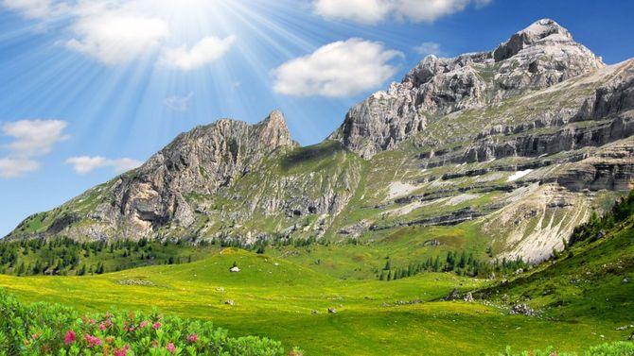
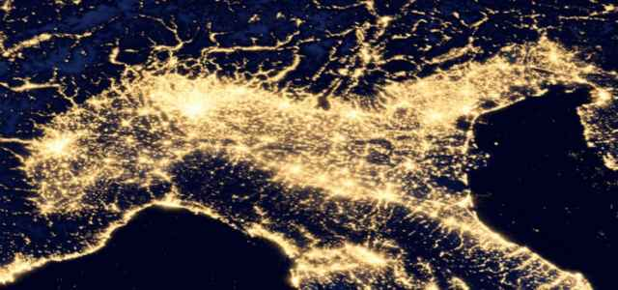
Northern Italy economy
Northern Italy's economy contributes considerably to the national gross domestic product. Since the unification of Italy and with the formation of the "industrial triangle" Milan, Turin and Genoa, it has a great importance for the economy of the peninsula.
It is always Northern Italy that drives the national economy. The preliminary estimates of regional GDP and employment published by ISTAT show that in the North-West and North-East (+1.8%) the Gross Domestic Product recorded a higher growth than the national average. In fact, lower dynamics were recorded in the South (+1.4%) in Central Italy (+0.9%).

Slide 9
Difficulties for young people
Increasingly poor and exploited young people. This is certified by Eurostat, in fact, according to which the number of unemployed and inactive people under 35 is 23%: over three million of our young people do not study or work and are not even looking for one and it is the highest percentage in Europe.
Given the dramatic data on current youth employment in Italy, which is the only EU country with an employment rate of young people between the ages of 25 and 29 below 60%.

Slide 10
Realized by:
Cinquino Amelia
Renda Isabella
Angelo Salvatore
Scovazzo Mimmo

