Slide 1
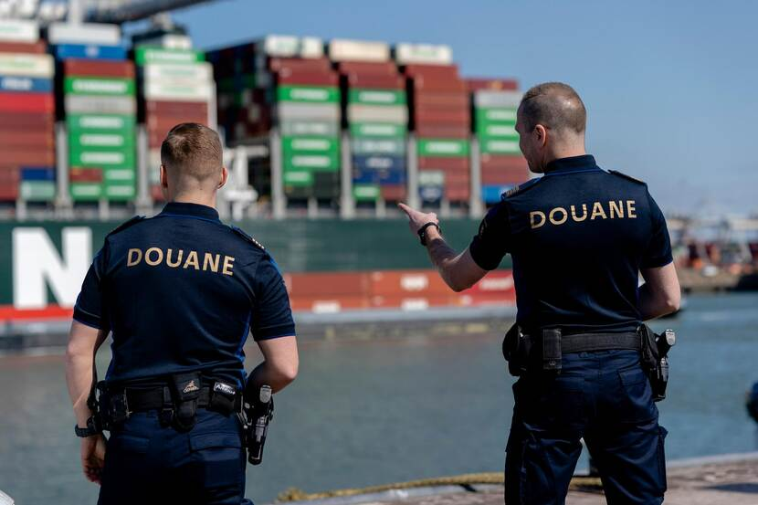
Jobs in logistics
Customs officer & truckdriver

Slide 2
Responsibilities & tasks
COSTUMS OFFICER | TRUCKDRIVER
Prevent illegal and dangerous goods | Drive long distances to deliver goods to customers.
Searching baggage | Refuel and clean vehicle.
Writing reports | Load and unload cargo.
detecting and prosecuting drug smugglers | Report road incidents to the dispatcher.
making arrests of people suspected of smuggling | Follow accident procedures.
dealing with revenue due on imported goods | Plan routes using GPS system.
checking documentation relating to imported goods | Get goods to the client on time.

Slide 3
Average salary of a customs officer

Slide 4
Advantages and disadvantages Custom officer
Advantages | Disadvantages
You fight crime and ensure justice and safety | You don’t know what you can find in the bags
varied job where you sometimes come across special objects. | sometimes you have to deal with people who become angry or agressive.
fringe benefits in addition to a good salary | Not everyone speaks Dutch or English
 | Sometimes you have to hand out fines and arrest people

Slide 5
Career possibilities customs officers

Slide 6
Vacancies for customs officers

Slide 7
Average salary of a truckdriver

Slide 8
Advantages and disadvantages of a truck driver
Advantages | Disadvantages
Flexible working hours | Long distances
You work alone | Not much at home
It’s fun if you like to travel | Long driving

Slide 9
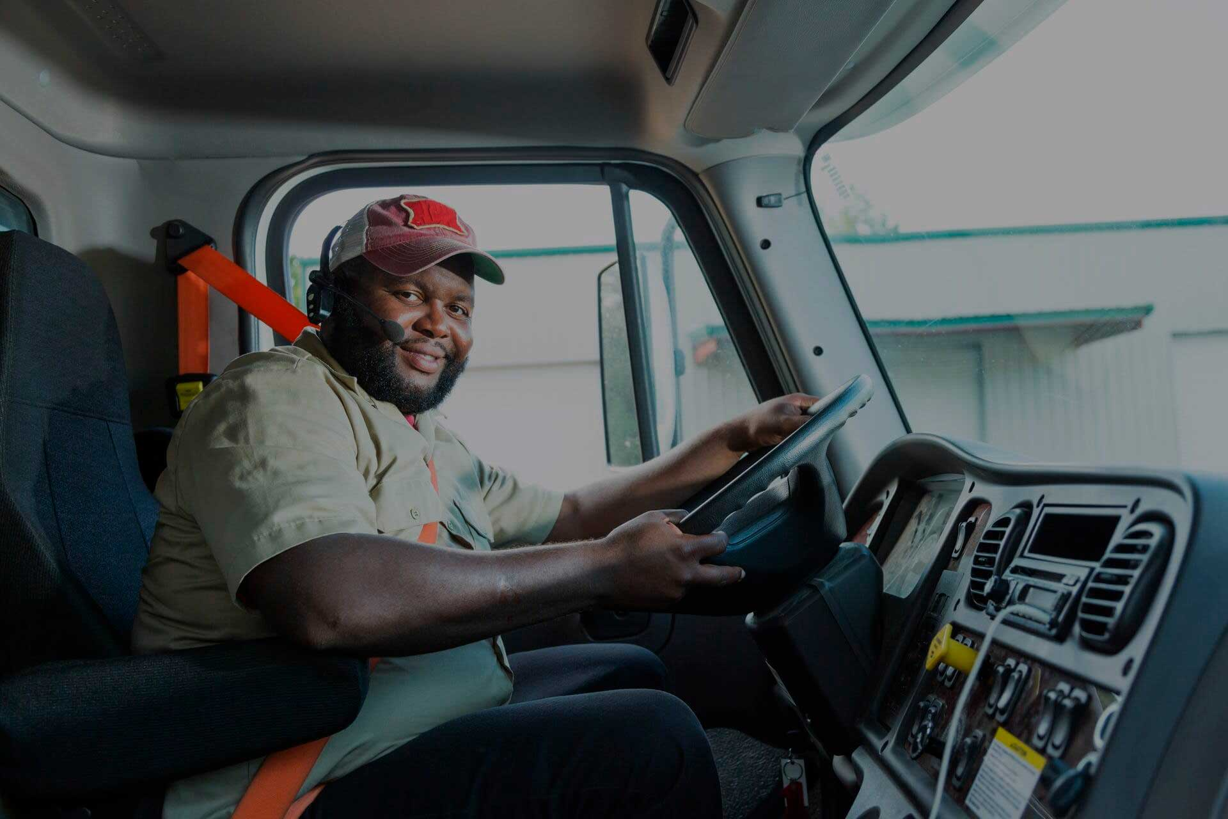
Career posibilities truck driver
Warehouse worker.
Forklift operator.
Bus driver.
Driving instructor.
Equipment operator.
Crane operator.
Mechanic.
Driver.

Slide 10
Vacancies truck drivers

Slide 11
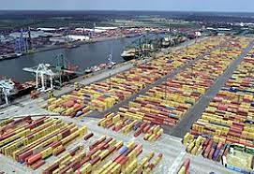
Customs officers and truck drivers at the Port of Antwerp
Custom’s officers have to check all the containers that arrive at the port.
Truckdrivers pick up containers at the port

Slide 12
THANK YOU FOR LISTENING.

