Slide 1
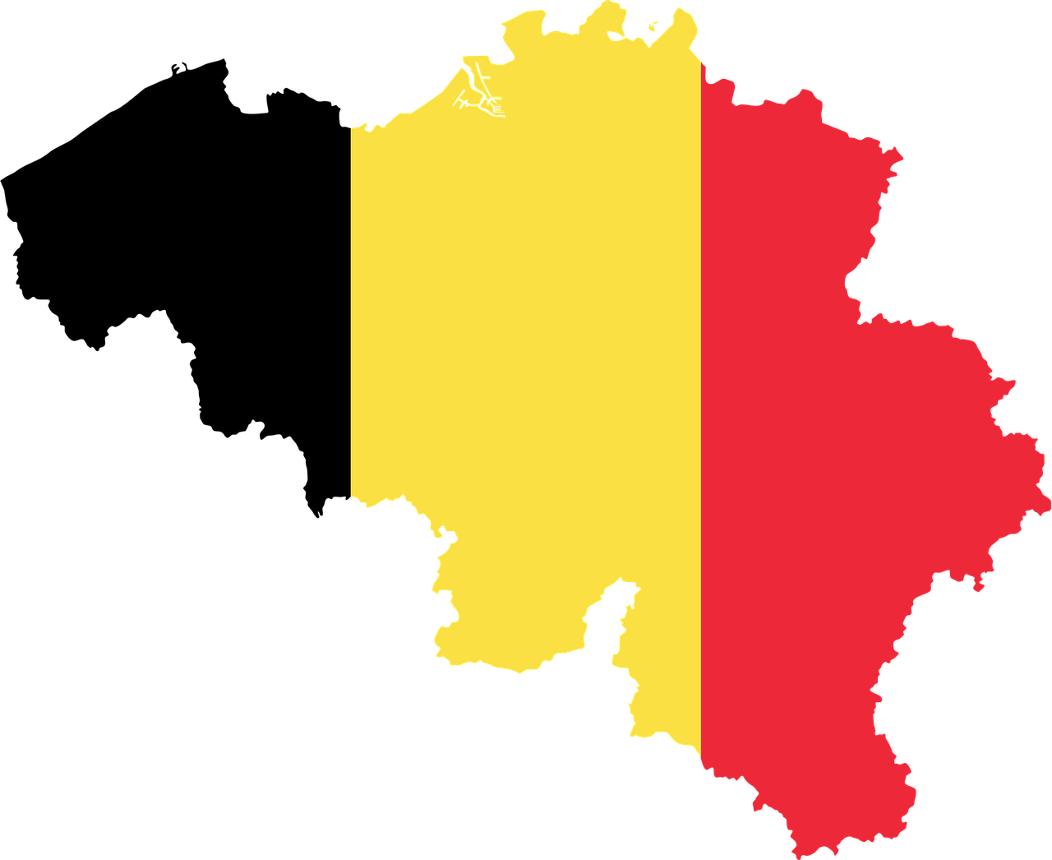
Belgium

Slide 2
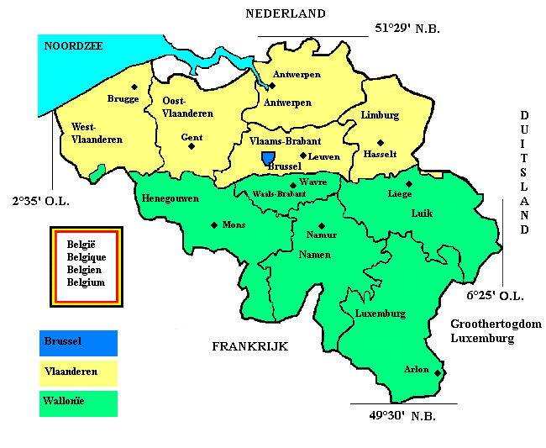
Districts
Flanders
Brussels Capital Region
Wallonia

Slide 3
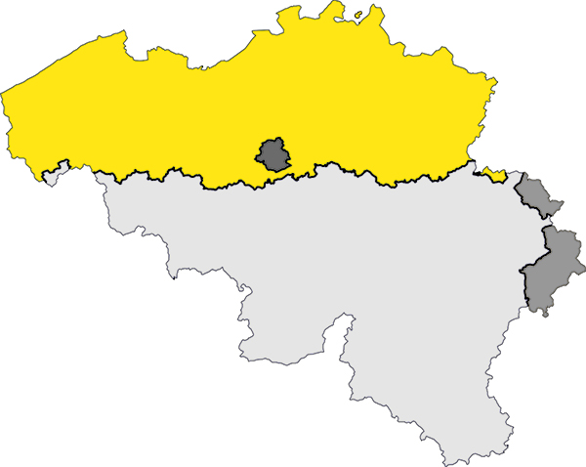
Language areas
French
Dutch
German

Slide 4
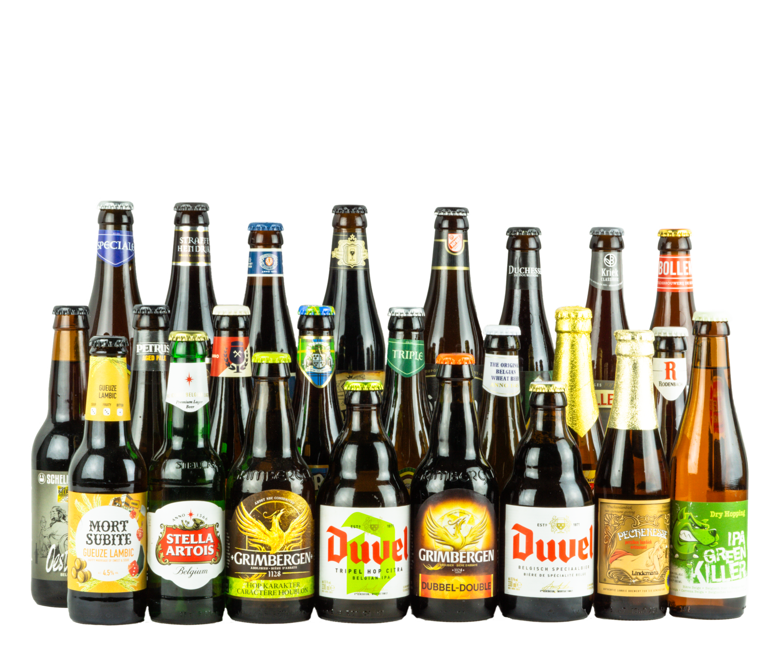
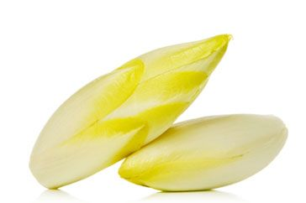
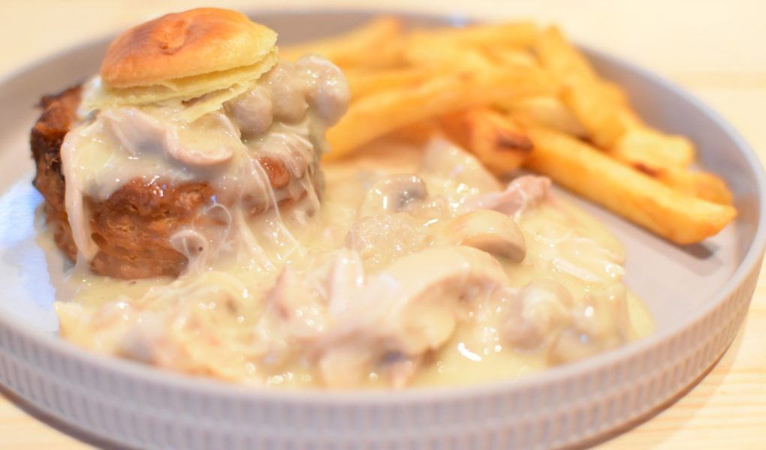
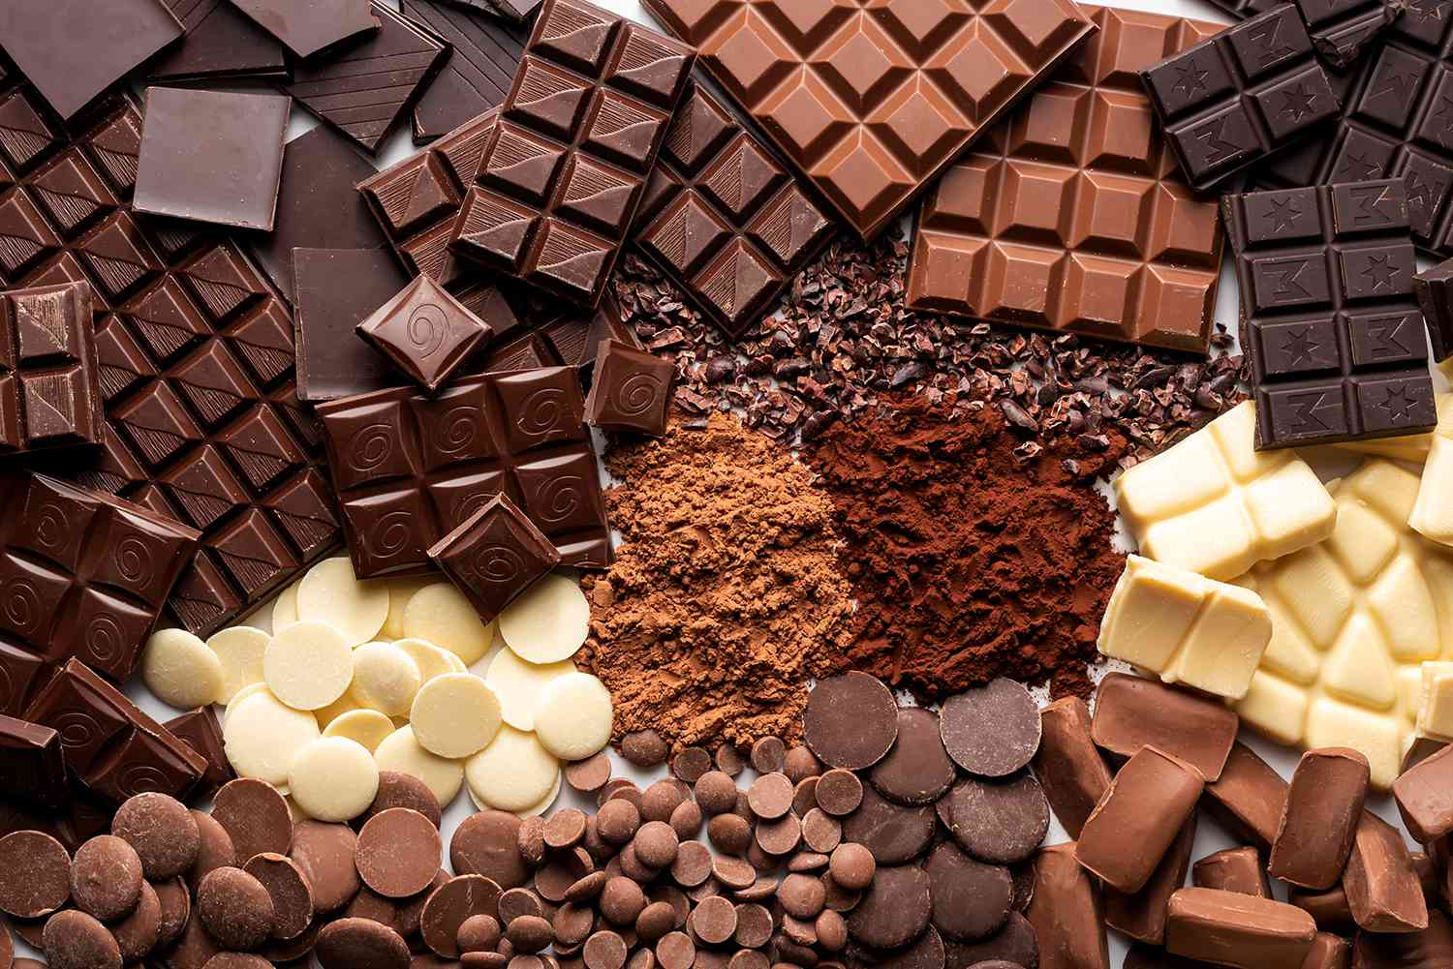
Traditional nutrition
Beer
French fries
Beef Stew
Vol-au-vent
Brussels Sprouts
Chocolate
Chicory

Slide 5
Cycling
Comics
Gourmet
Soccer

Slide 6
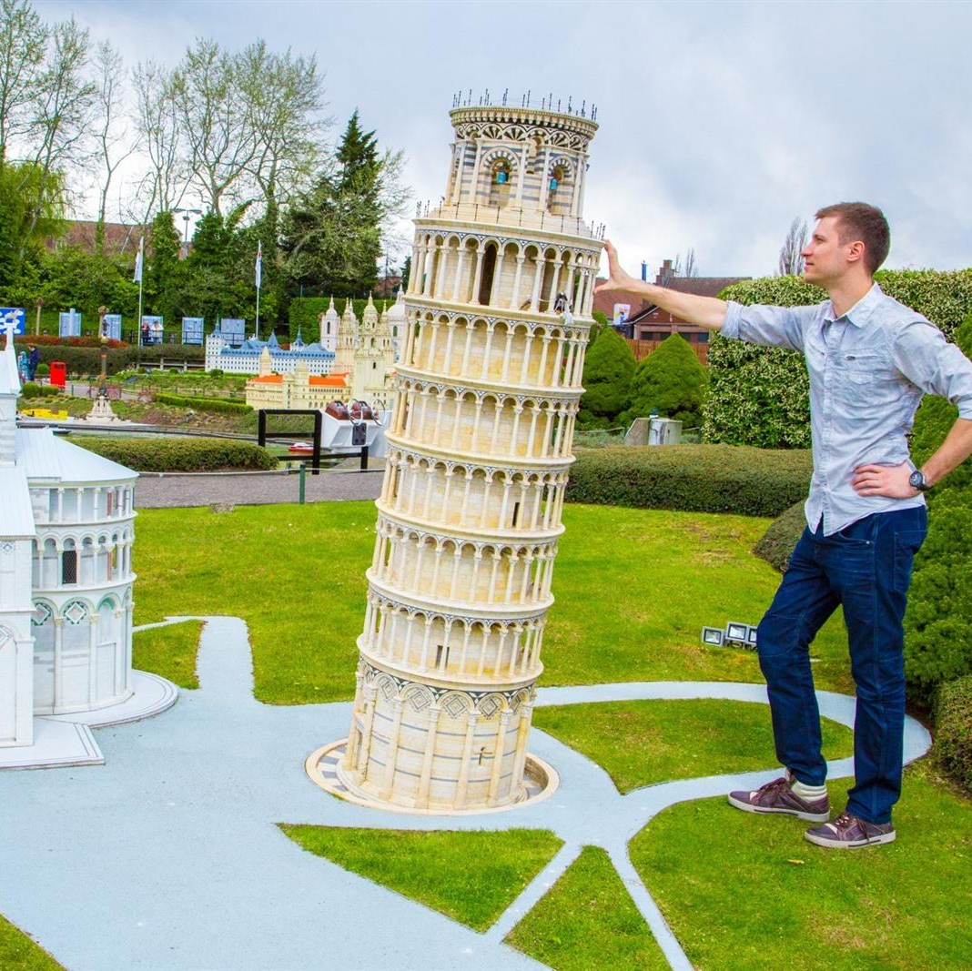
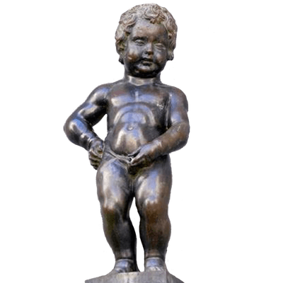
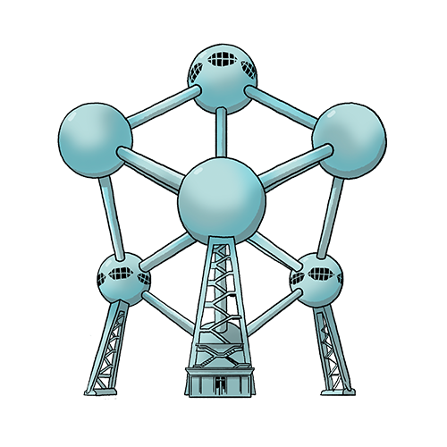
Sights
Atomium
Manneken-Pis
Central Station Antwerp
Mini Europa
Antwerp port
Royal Palace
Chocolate Nation

Slide 7
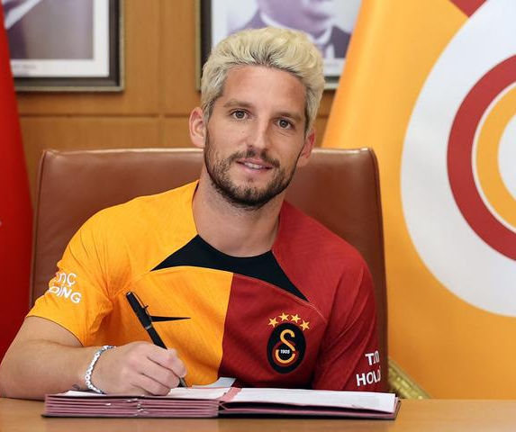
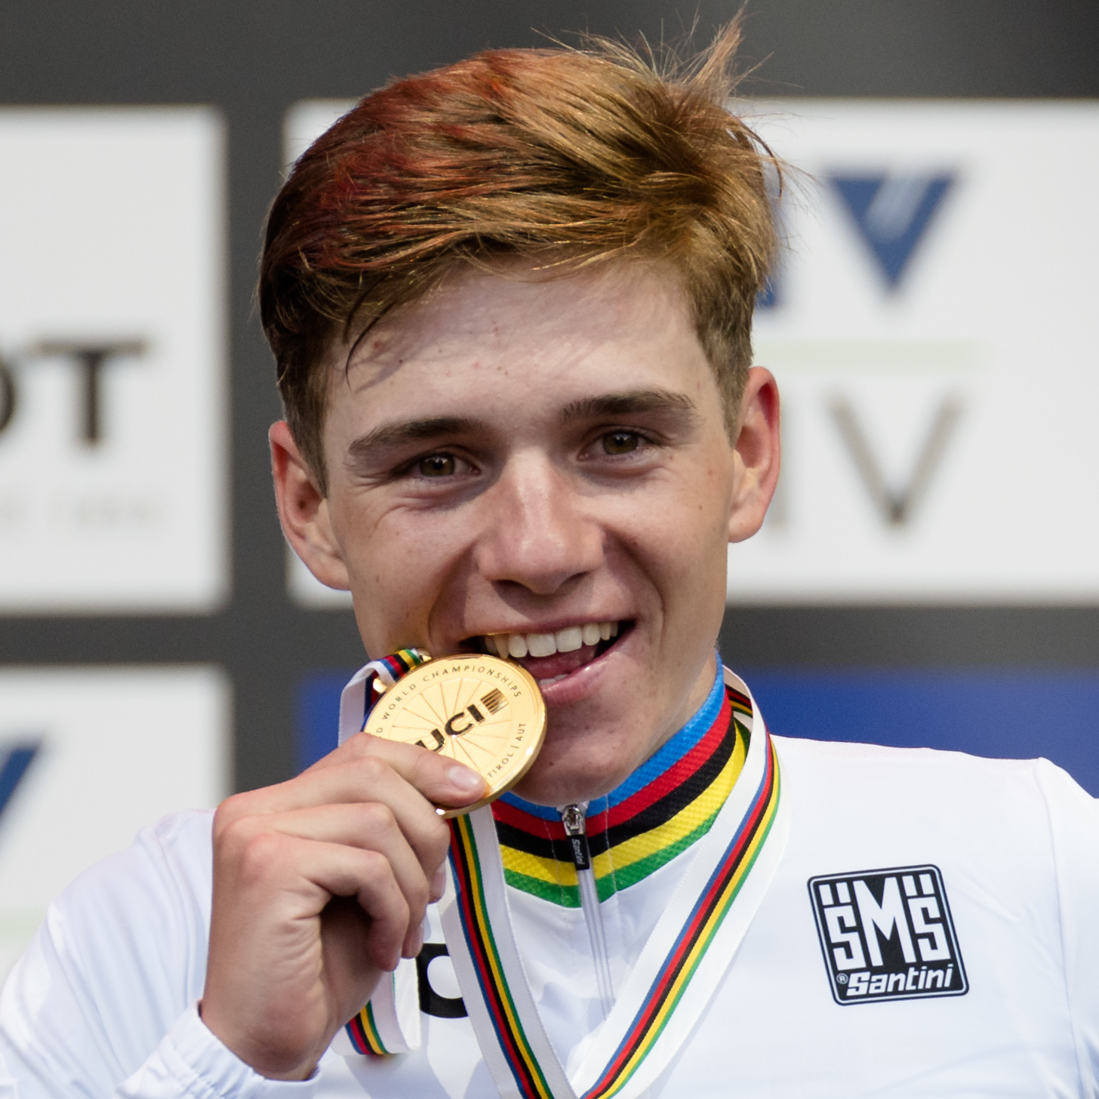
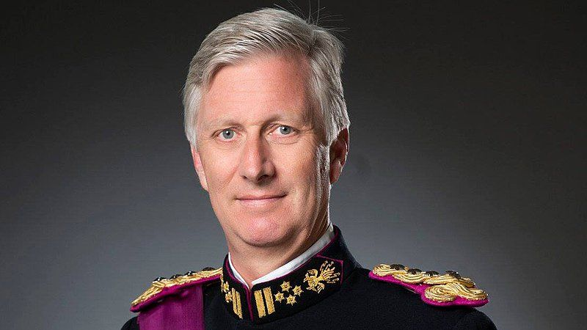
Famous Belgian people
Romelu Lukaku
Dries Mertens
The Smurfs
Remco Evenepoel
Eddy Merckx
King Filip
Nina Derwael
Gert Verhulst

Slide 8
Population
Flanders: 6,6 million
Wallonia: 3,6 million
Brussels: 1,2 million
Total: 11,4 million

Slide 9
Scholar system
Kindergarten
Primary School
High School
University

Slide 10
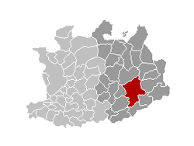
Geel
Kempen
40.000 inhabitants
11 boroughs
109,8 km²

Slide 11
Wallonia
Hills & mountains
French
Woods & nature
5 provinces

Slide 12
Video

