Slide 1
Customer Agent Crane Driver
Adam Zakariev

Slide 2
Customer Agent

Slide 3
What companies offer these jobs?
Warehouses
Different stores
Different businesses

Slide 4
How much does it pay?
Average workers make around €38000 a year
Around €2000 a month

Slide 5
What are some of your responsibilities and/or tasks?
Listen to customers’ concerns
Answer customers
Maintain a positive attitude
Open new customer accounts

Slide 6
How many vacancies are there?
There are over 5000 vacancies

Slide 7
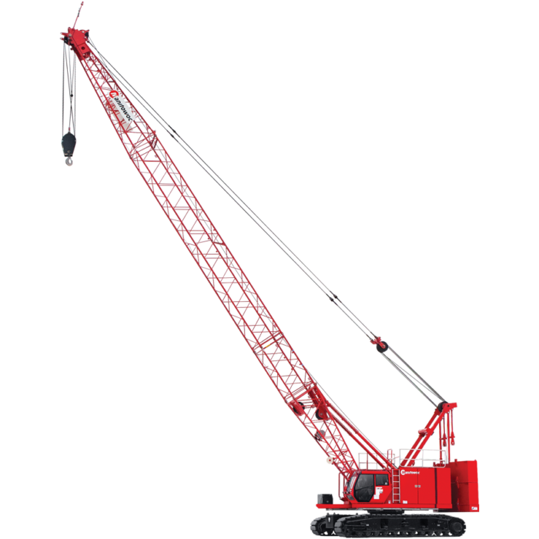
Crane driver

Slide 8
How much does it pay?
Average workers make around €38000 - 60000 a year
Around €2000 - 4000 a month

Slide 9
Which companies offer these jobs?
Construction work
In a big warehouse
At Port Of Antwerp

Slide 10
What are some of your responsibilities and/or tasks?
lifting and moving materials around a construction site as safely and efficiently as possible

Slide 11
How many vacancies are there?
There are over 1000 vacancies online

